Slide 1

CSE211
Computer Organization and Design
Lecture : 3 Tutorial: 1 Practical: 0 Credit: 4

Slide 2
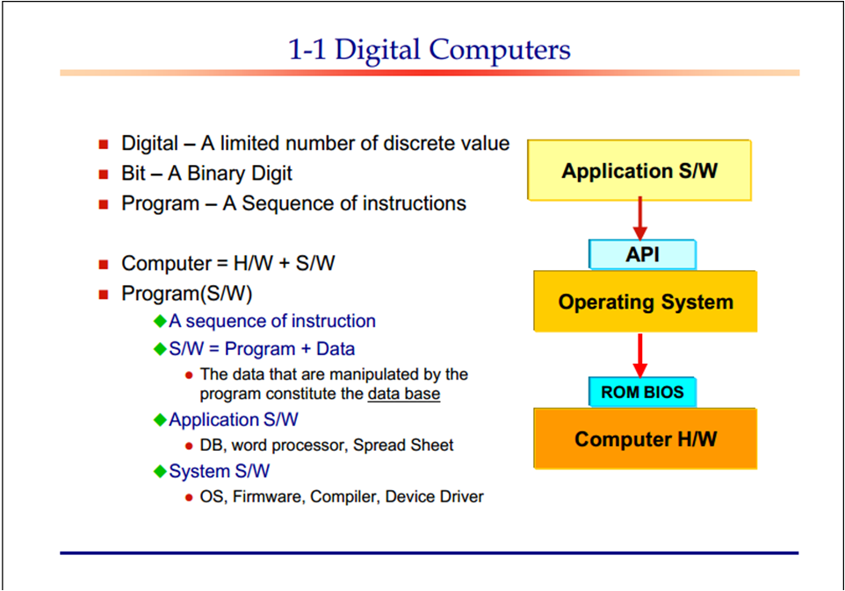

Slide 3
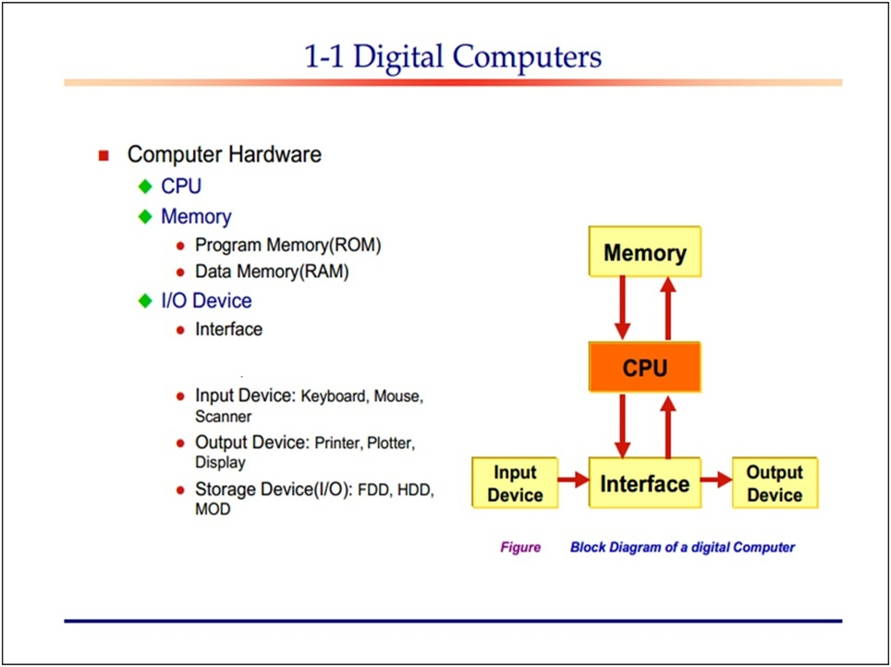

Slide 4
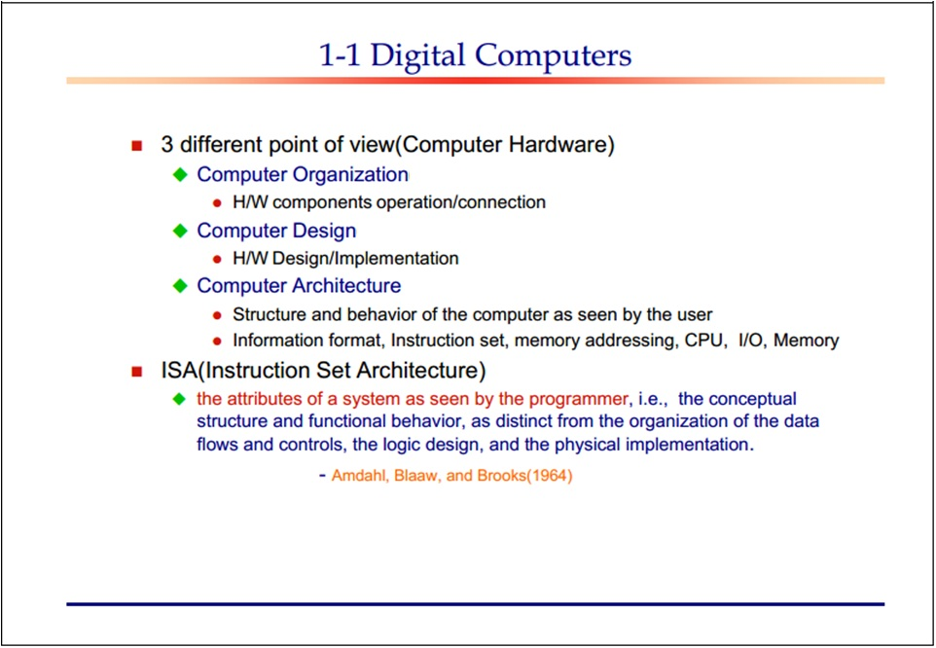

Slide 5
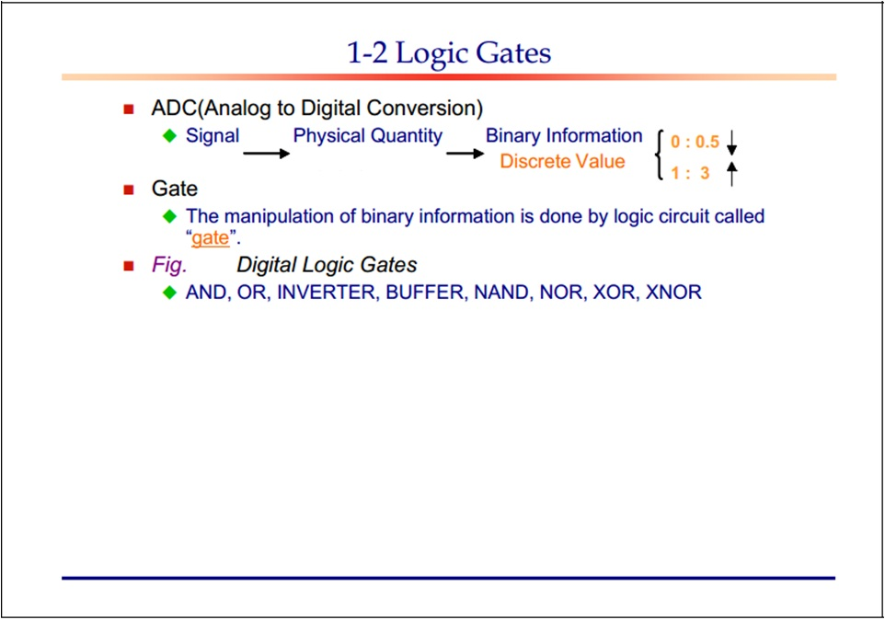

Slide 6
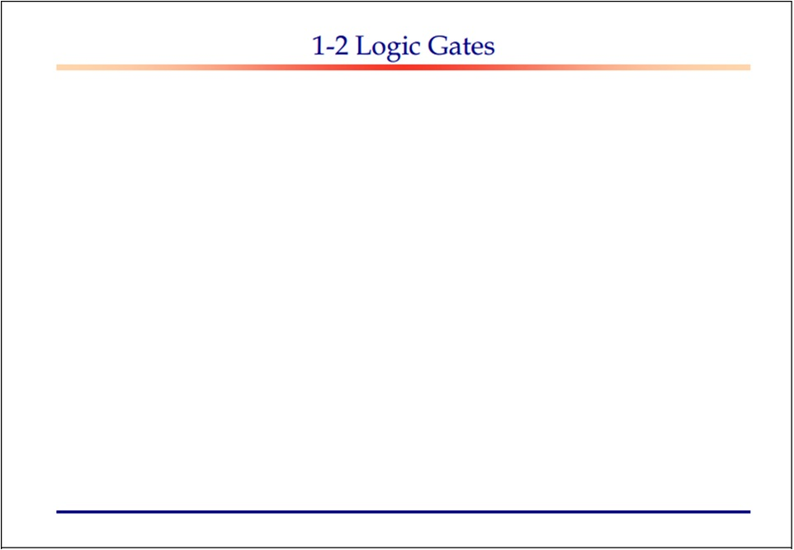
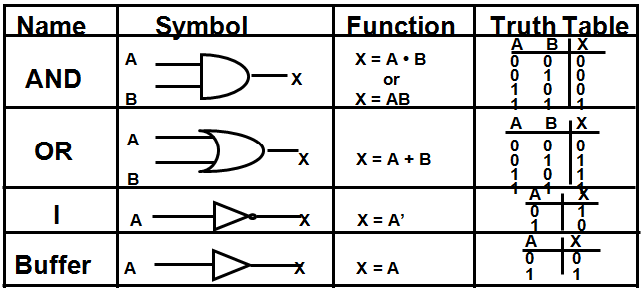

Slide 7
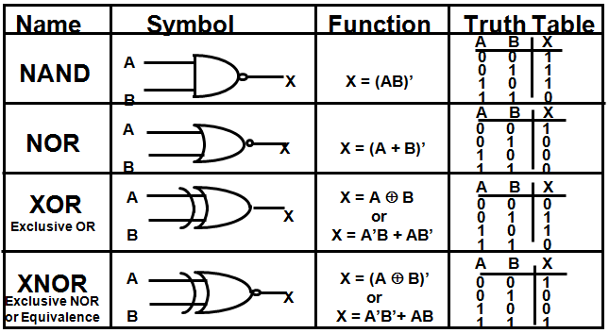

Slide 8
Combinational Circuits
In this output depends only upon present input.
Speed is fast.
It is designed easy.
There is no feedback between input and output.
This is time independent.
Elementary building blocks: Logic gates
Used for arithmetic as well as boolean operations.
Combinational circuits don’t have capability to store any state.
As combinational circuits don’t have clock, they don’t require triggering.
These circuits do not have any memory element.
Examples – Encoder, Decoder, Multiplexer, Demultiplexer

Slide 9
Sequential Circuits
In this output depends upon present as well as past input.
Speed is slow comparative to combinational circuits.
It is designed tough as compared to combinational circuits.
There exists a feedback path between input and output.
This is time dependent.
Elementary building blocks: Flip-flops Mainly used for storing data. Sequential circuits have capability to store any state or to retain earlier state.
As sequential circuits are clock dependent they need triggering.
These circuits have memory element.
Examples – Flip-flops, Counters

Slide 10
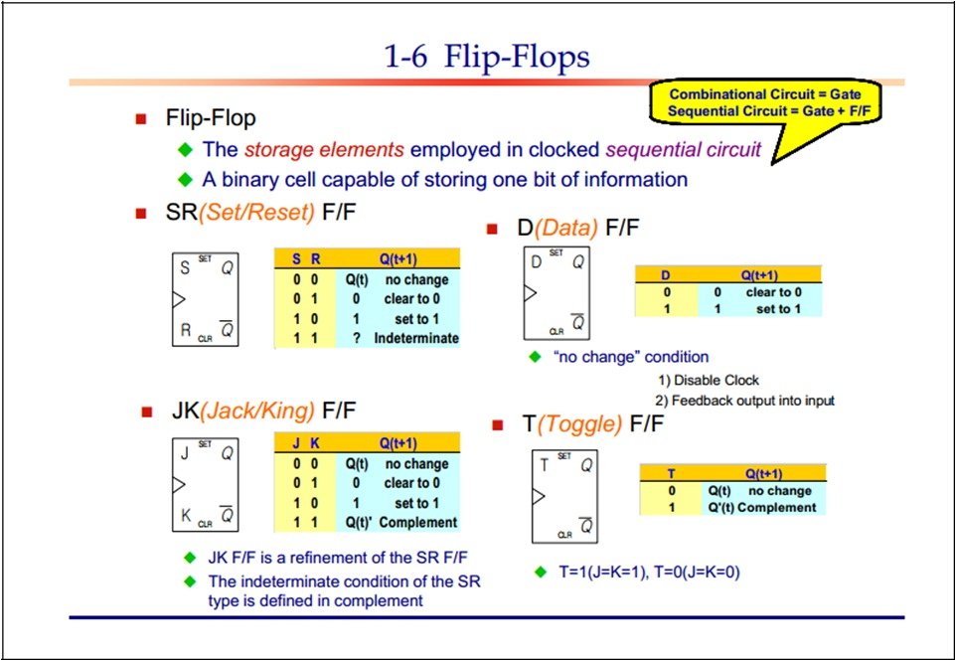

Slide 11
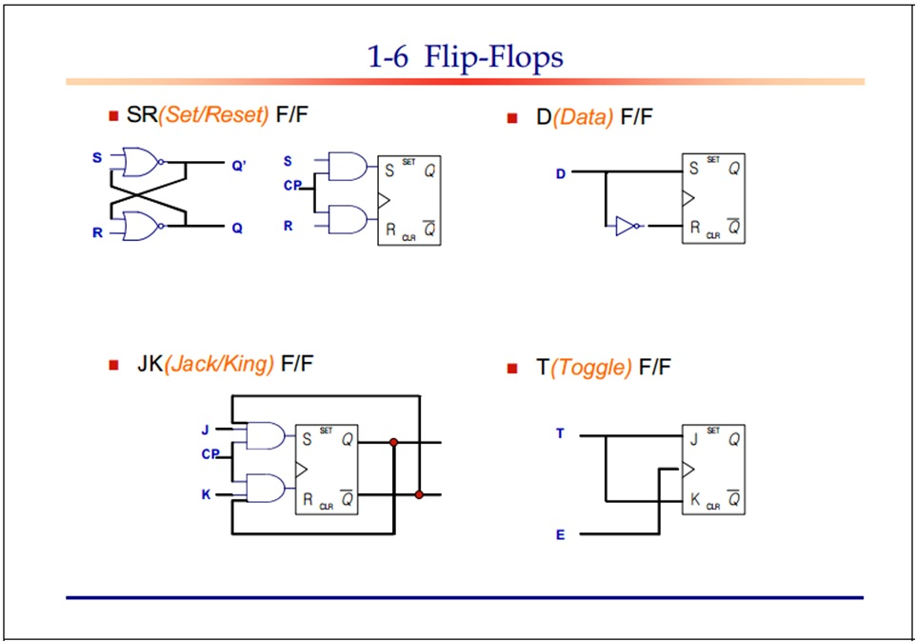

Slide 12
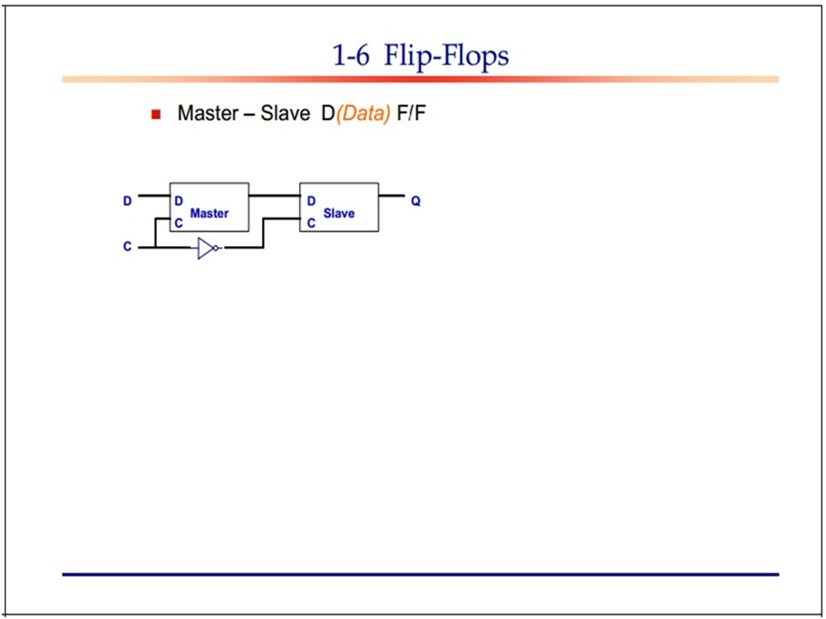
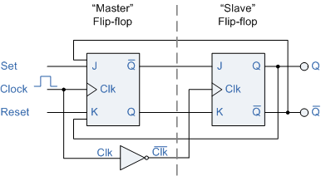
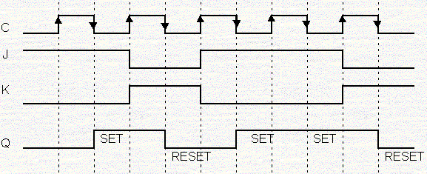

Slide 13
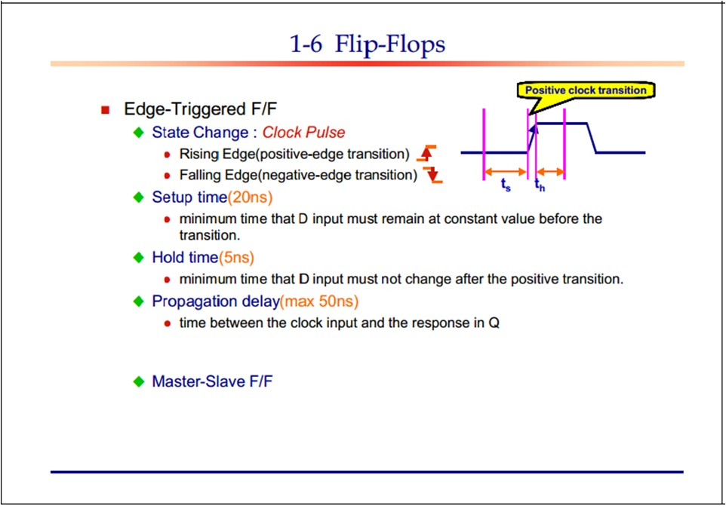

Slide 14
Integrated Circuits
An IC is a small silicon semiconductors crystal called chip containing the electronic components for digital gates.
Various gates are interconnected inside chip to form required circuit.
Chip is mounted in ceramic/plastic container connected to external pin
Small scale Integration (SSI) : less than 10 gates
Medium Scale Integration(MSI) : between 10 to 200 gates (decoders, adders, registers)
Large Scale Integration(LSI) : between 200 and few thousands gates ( Processors, Memory Chips)
Very Large Scale Integration (VLSI) : Thousands of gate within single package ( Large Memory Arrays, Complex Microcomputer Chips)

